Slide 1
Living with chronic pain
Surviving To Thriving!
Presenters:
Susan Bash, lcsw
Bill Simpson lmt, cpc, cwppm
Family Practice & Counseling Network

Slide 2
A program of Resources for Human Development (RHD).
A network of community health centers providing comprehensive Primary Care, Dental, and Behavioral Health Services.
Opened with an initial Health Resources and Services Administration (HRSA) grant in 1992, and has since grown and developed in response to need and demand by the communities served (20,000+ to date).
Three comprehensive health centers and one convenient health center in Philadelphia, and one health center in York, PA.

Slide 3
FPCN’s Mission
To provide quality, comprehensive health services to all the people we serve, with special attention to residents of public housing communities and vulnerable people. Beliefs that support the mission include:
Quality health care is a right, not a privilege
No one will be turned away because of inability to pay
Health centers work best when they are partnerships between consumers and staff
Health education is vital to empower individuals to make choices about their health
Health care must be delivered in a competent, sensitive and compassionate manner by caring for the whole person…mind, body, emotion and spirit;

Slide 4
Who Are We?
Susan Bash, LCSW
Bill Simpson, LMT, CPC, CWWPM

Slide 5
Living with Chronic Pain
From Surviving To Thriving!
What is Chronic Pain
Biopsychosocial Model of Pain
Other Factors Related to Pain
Assessing Pain
Ways to Deal with Pain
Statistical Results of FPCN Chronic Pain Program
Experiential Activities (Take care of yourself)
Q & A

Slide 6
FPCN
Living with Chronic Pain
Program
Interview process
6 week program
Assessment week 1 and week 6
Upon “graduation” move to on-going support group

Slide 7
Assessing pain
The Duke Health Profile
The American Chronic Pain Association

Slide 8
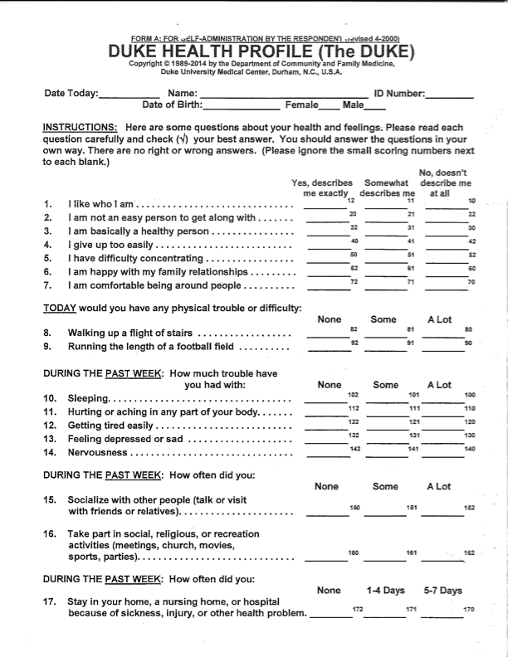
Duke Health
Profile

Slide 9
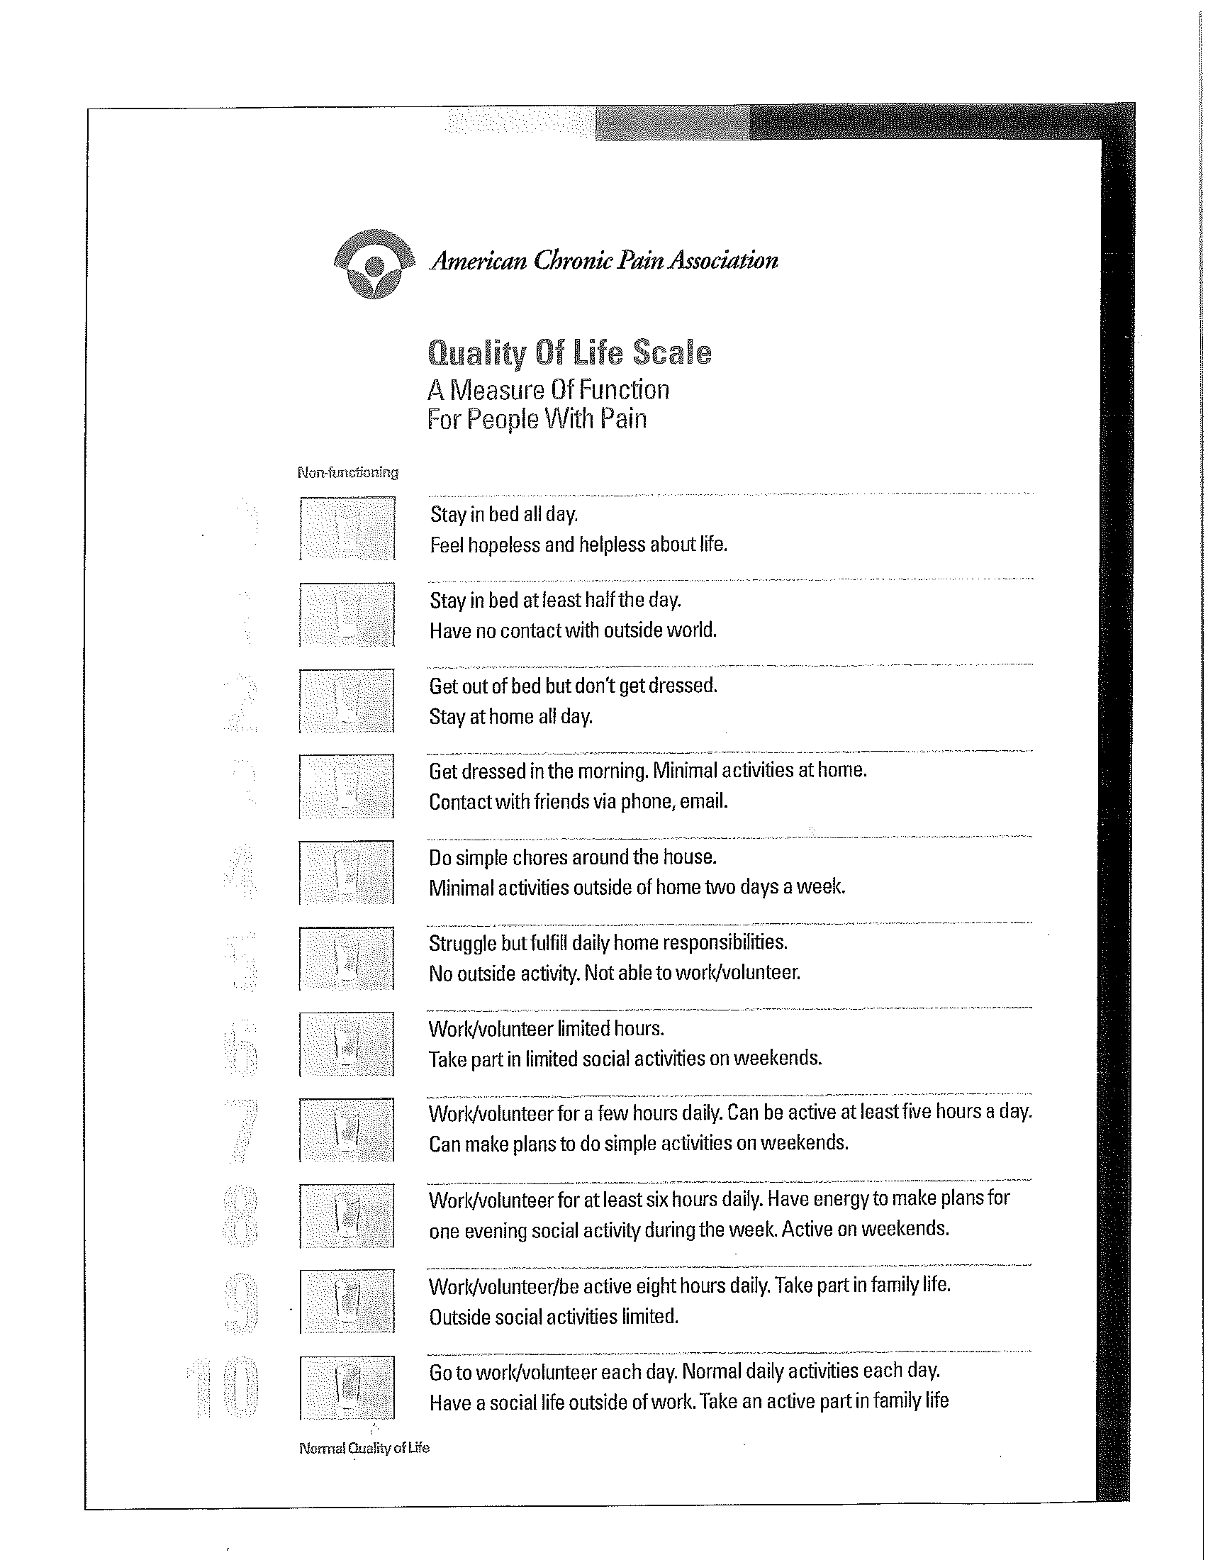
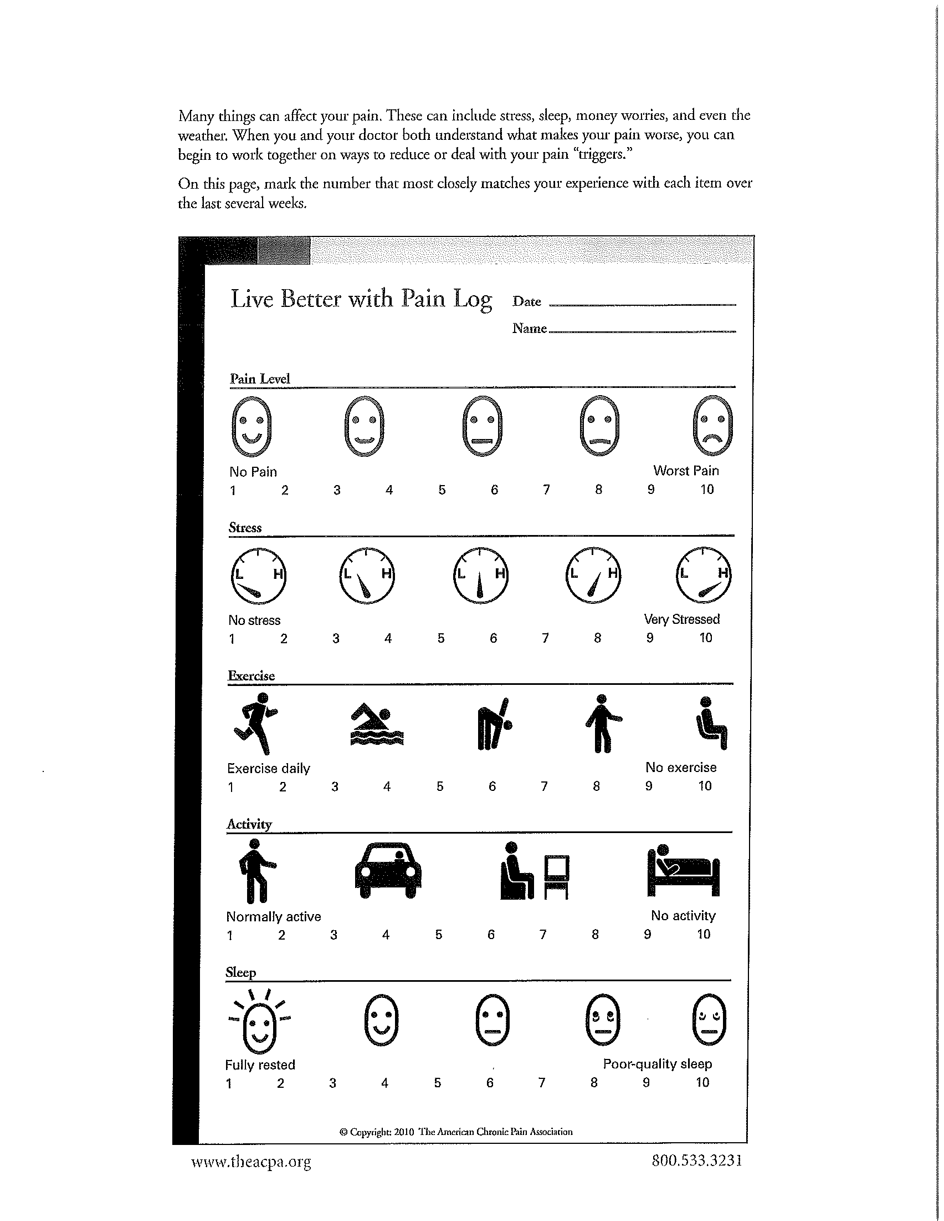
American Chronic Pain association

Slide 10
Chronic Pain Program
Acute vs Chronic Pain
Biopsychosocial Model
Other Factors Related to Pain
Ways to Deal with Pain

Slide 11
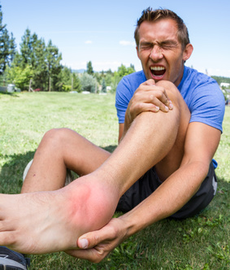
Acute Pain vs chronic Pain

Slide 12
Acute Pain
Pain is brief in duration
Lasts a few seconds - 6 months
Cause of pain is generally known

Slide 13
Chronic Pain
Non-life-threatening pain lasting 6 months or more
Cause often unknown
Could be from previous injury long since recovered or…
Absence of any past injury or evidence of body damage

Slide 14
BioPsychoSocial Model of Chronic Pain
Negative Sensory and Emotional Experience
Physiologically and Psychologically Stressful
Co-occurs with Anxiety, Depression and Sleep Issues
Eventually Become Socially Isolated

Slide 15
PAIN IS A REALITY
Pain is real AND is stress-related
Pain triggers Stress
Stress makes Pain worse
Stress can be made better or worse depending on how one thinks about pain
Learning about Stress & Pain can help you live a more comfortable life

Slide 16
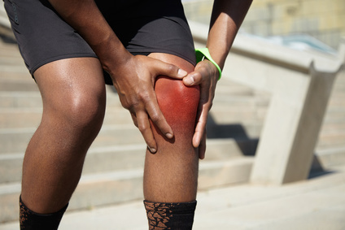
other factors related to pain
Anxiety
Depression
Overactivity
Inactivity
Focus on Pain
Insomnia

Slide 17
Ways to Deal with Pain
Medication
Posture & Movement
Sleep Hygiene
Diet
Mindfulness
Peer Support

Slide 18
medication
Acetaminophen & NSAIDS
Opioids
Adjuvants

Slide 19
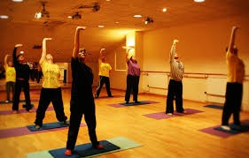
Posture & Movement
Proper Posture
Body Mechanics
Gentle Movement

Slide 20
sleep hygiene
Avoid caffeine, tobacco, alcohol, clock-watching, and leaving TV on
Wind-down time/snack before bed
Keep room dark, comfortable temperature, and reduce noise
Exercise

Slide 21
diet
Balanced diet
Avoid foods that may cause inflammation
Stay hydrated
Weight loss

Slide 22
mindfulness
Breathing
Meditation
Life Skills-ACT
Self-Compassion

Slide 23
peer Support
Not alone in their pain
Social connectedness
Someone to talk to about their pain (or not)

Slide 24
Support group
activities
Potting plants
Field trip to Japanese Garden
Music
Dancing
QiGong (gentle movement)
Poetry
Mandala/Affirmation coloring

Slide 25
statistical RESULTS
18.75%
62.5%
18.75%
81.25%

Slide 26
Surviving…

Slide 27
…Thriving!

